Slide 1

THE SCIENCE OF FIDELITY AND INFIDELITY

Slide 2
We need a science of fidelity to understand infidelity
You cannot develop a science of infidelity without also understanding fidelity, loyalty, continuing love, and trust.
Therefore, we must understand how couples build (or erode) TRUST.
We must understand the principles of INTIMATE TRUST, lasting romance, passion, and love, as well as their erosion. CHERISHING vs NEG COMPs
We must understand how couples either build LOYALTY or build BETRAYAL

Slide 3
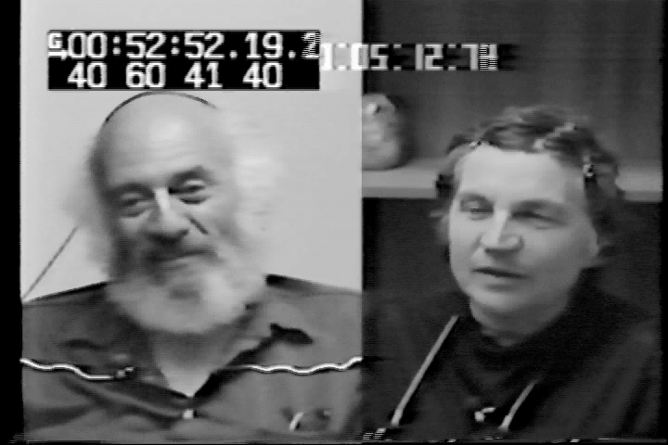

Slide 4
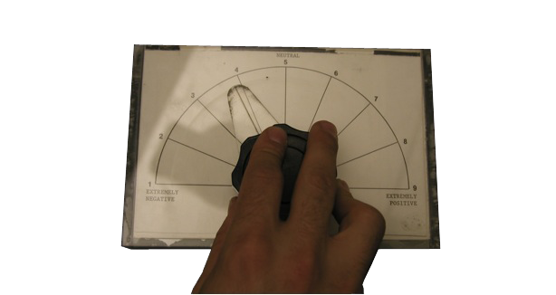
The Levenson-Gottman Video-Recall Rating Dial

Slide 5
Three Measurement Domains
Behavior: Using video tape, computer-assisted coding and then weighting the emotion coding data
Perception: Using video recall procedure and rating dial
Physiology: Using autonomic data (heart rate, blood velocities to ear and finger, palmar skin conductance, gross motor movement)

Slide 6
First look at behavior: Cumulative “Dow-Jones” Average of an interaction

Slide 7
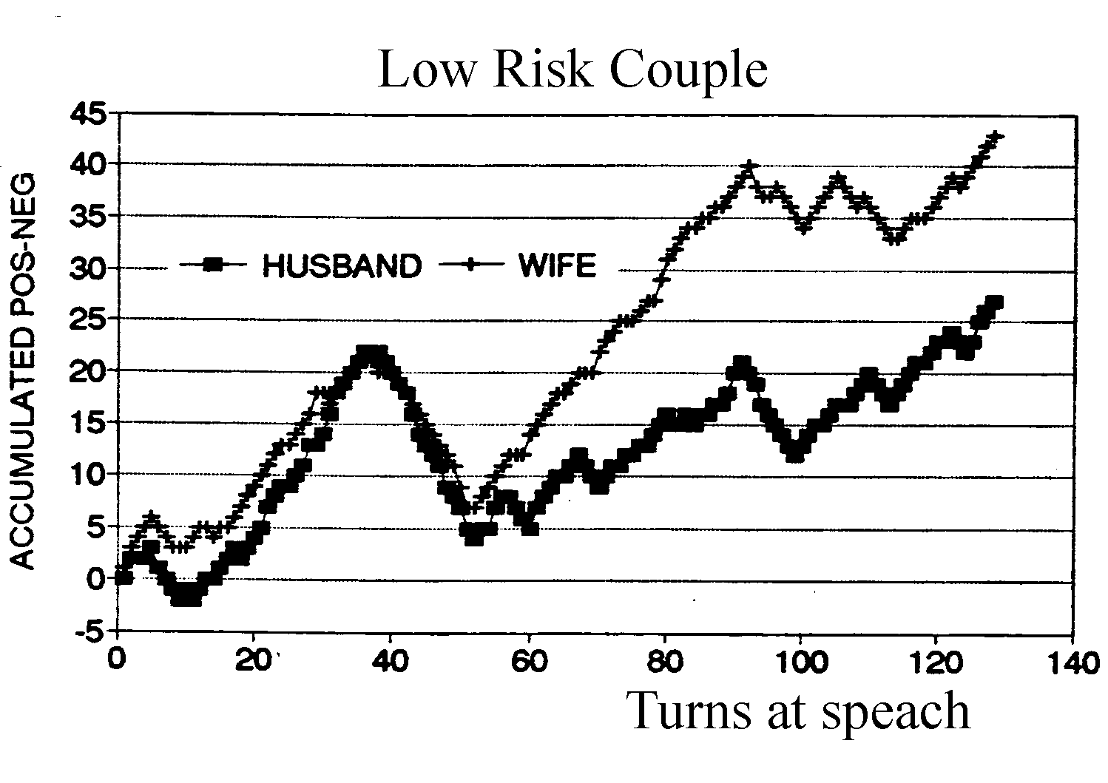
Cumulated Data Representation: Typical Data for Low Risk Couple during conflict
Stable
marriage
Examples:
affection +4
disgust -3
whining -1
contempt -4
5 to 1
positive to negative ratio

Slide 8
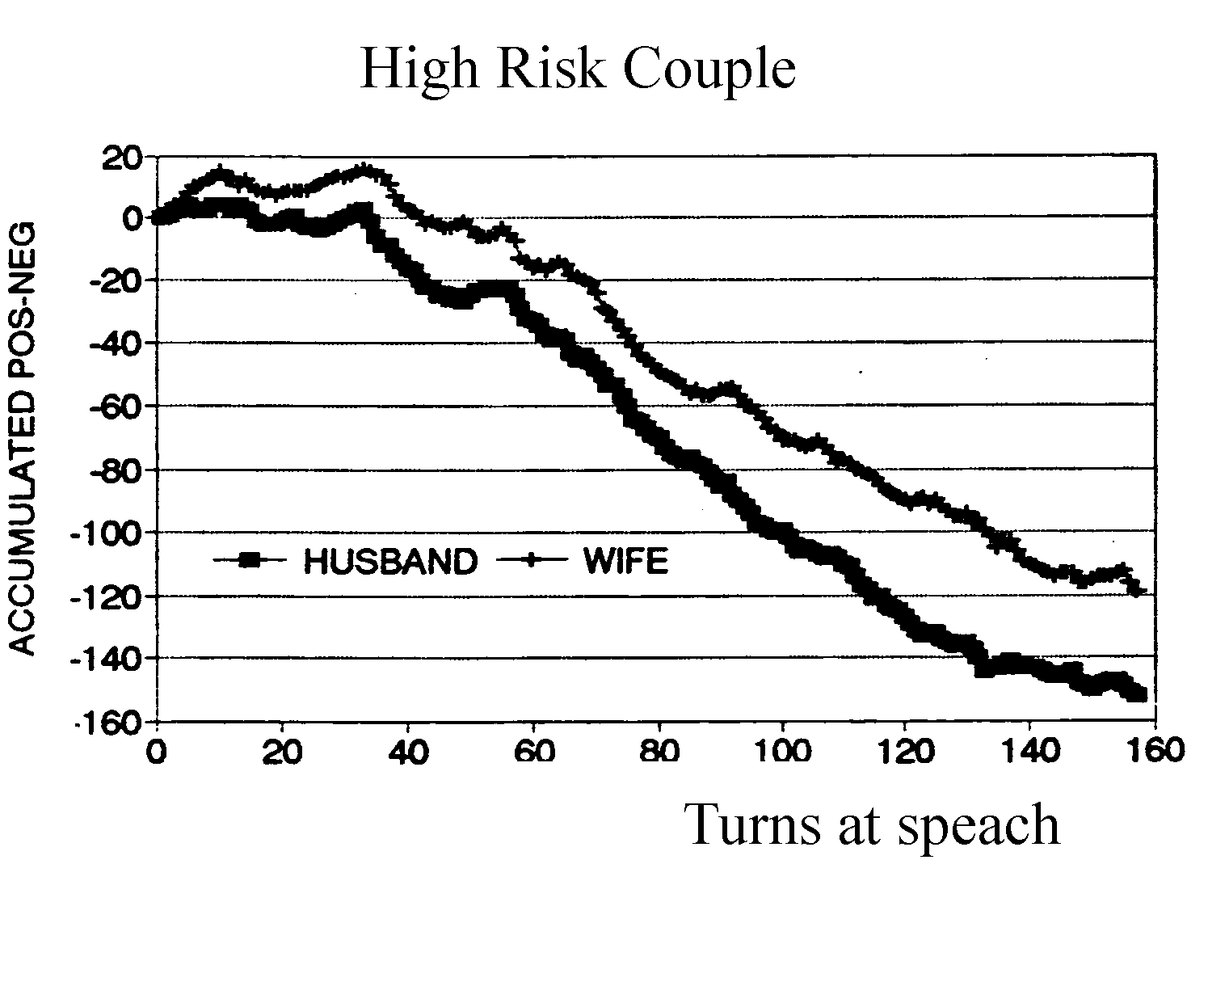
Typical Cumulated High Risk Couple’s Interaction during conflict
Unstable
marriage
0.8 to 1
positive to negative ratio

Slide 9
Early findings with the Dow Jones graph of a conversation

Slide 10
Later discovered three outcomes with 14-year follow up data. Middle group emotion dismissing couples

Slide 11
Now let’s think of the history of a typical love relationship
In two stages
STAGE 1: Falling in love & romance
STAGE 2: Building a lasting love

Slide 12
STAGE 1: The Physiology of Falling In Love– Only Certain People Can Trigger the Complex Cocktail’s Cascade
DHEA (dehydro-epi-androsterone), natural amphetamine high, readiness for sex
Pheromones, sex scents, smell and attraction
Oxytocin, touch, s/he feels just right to hold, the cuddle hormone, bonding, also reduces fear and good judgment
PEA (phenyl-ethyl-amine), spikes at ovulation – regulates approach and romance, hormone of love at first sight, highs of limmerance
Estrogen, softness, receptivity
Testosterone, aggressive sexual desire, lust, horny-ness
Serotonin, emotional sensitivity, low irritability
Dopamine, excitement, pleasure, motivation, risk taking, anticipation of reward
Progesterone, sedating, can be calming so it needs inhibition
Prolactin, reduces aggression, increases nurturance
Vasopressin, monogamy molecule, aggressive possessiveness in males
Notes:
This is STAGE 1: SYSTEM 1 THINKING, OBSESSIVE THOUGHT. OXYTOCIN, THE HORMONE OF BONDING, ALSO SUSPEND FEAR, AND POOR JUDGMENT, WE IGNORE RED FLAGS THAT OUR LOVER IS UNTRUSTWORTHY. DOPAMINE: THE FEELING THAT SOMETHING BIG AND WONDERFUL IS ABOUT TO HAPPEN IF WE EXPLORE AND TAKE RISKS.

Slide 13
There are only some people who qualify in each stage
STAGE 1: The cocktail cascade of falling in love in our body is characterized by Kahneman’s “System 1” thinking (Ignore red flags, “Blink” thinking)
Only some people will be selected by our bodies and minds by System 1 as potential candidates for a relationship.
STAGE 2: Then, as the relationship proceeds toward commitment, the poor judgment haze produced by oxytocin, dopamine, and testosterone FADES, and
Kahneman’s “System 2” is activated (logic, judgment)
Then we attempt to build COMMITMENT, lasting TRUST & LOYALTY, lasting ROMANCE AND PASSION.

Slide 14
SO THE SECOND PHASE IS EVEN MORE SELECTIVE
The initial poor judgment haze produced by oxytocin, dopamine, and testosterone FADES, and
Kahneman’s “System 2” gets active. We use logic, and judgment. We start focusing on the Red Flags, as we attempt to build TRUST & LOYALTY with this person. “Perpetual problems” move to the forefront.
But how do we actually build trust & loyalty? What are the processes?
Or how do couples build distrust and betrayal?
Notes:
THIS IS STAGE 2. NOW, AS THE HAZE OF POOR JUDGMENT FADES, WE START SEEING THE RED FLAGS. AS WE START TO BUILD TRUST AND LOYALTY WE USE MORE AND MORE SYSTEM 2 THINKING. AS KAHNEMAN POINTS OUT THOUGH, SYSTEM 2 IS VERY LAZY, AND MAY JUST GIVE US THE IMPRESSION THAT WE DID THIS THINKING WHEN WE ACTUALLY DIDN’T.

Slide 15
Salvador Minuchin : “Every marriage is a mistake”
The very qualities attractive in Stage 1, often become annoying in Stage 2.
First 2 years of marriage = the most fighting.
Some couples stop fighting.
Other couples have the Four Horsemen predicts divorce in 5.6 years after wedding.
Most unhappy couples who stay together become disengaged, divorce 16.2 years after the wedding
Some go on to build lasting love.
What is going on here?

Slide 16
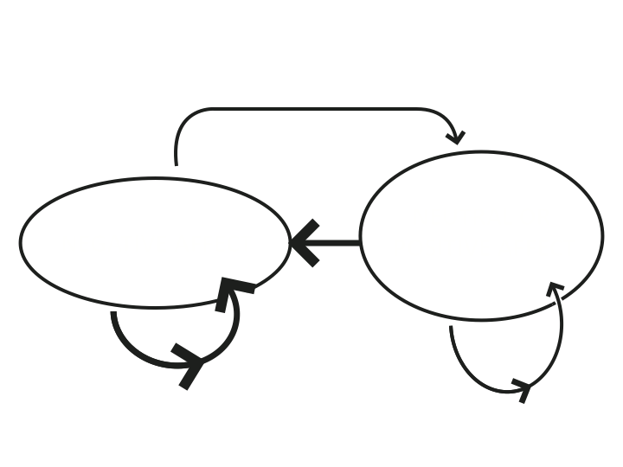
THE ANSWER: Use Hidden Markov Model Analysis –Negative affect is an absorbing state for unhappy couples: the probability of entry (thick line) exceeds the probability of exit (thin line)
NEGATIVITY
NEUTRAL OR POSITIVITY

Slide 17
We call it “The Roach Motel Model” of unhappy marriage: “They check in but they don’t check out”
THERE ARE REALLY ONLY 2 CONFLICT STYLES: For unhappy couples negative affect is like stepping into a quicksand bog.
Negative affect is a “Markov absorbing state,” but only for unhappy couples.
Repair does not work for them. REPAIR IS CENTRAL TO THE MASTERS OF RELATIONSHIPS! (also Gianino & Tronick)
Happily married couples are able to exit this negative state
WE WILL SEE LATER THAT IS BECAUSE they HAVE A HIGH TRUST METRIC,
SO THEY do effective repairs, like taking responsibility for even a part of the problem.
BUT WHAT IS “TRUST”?

Slide 18

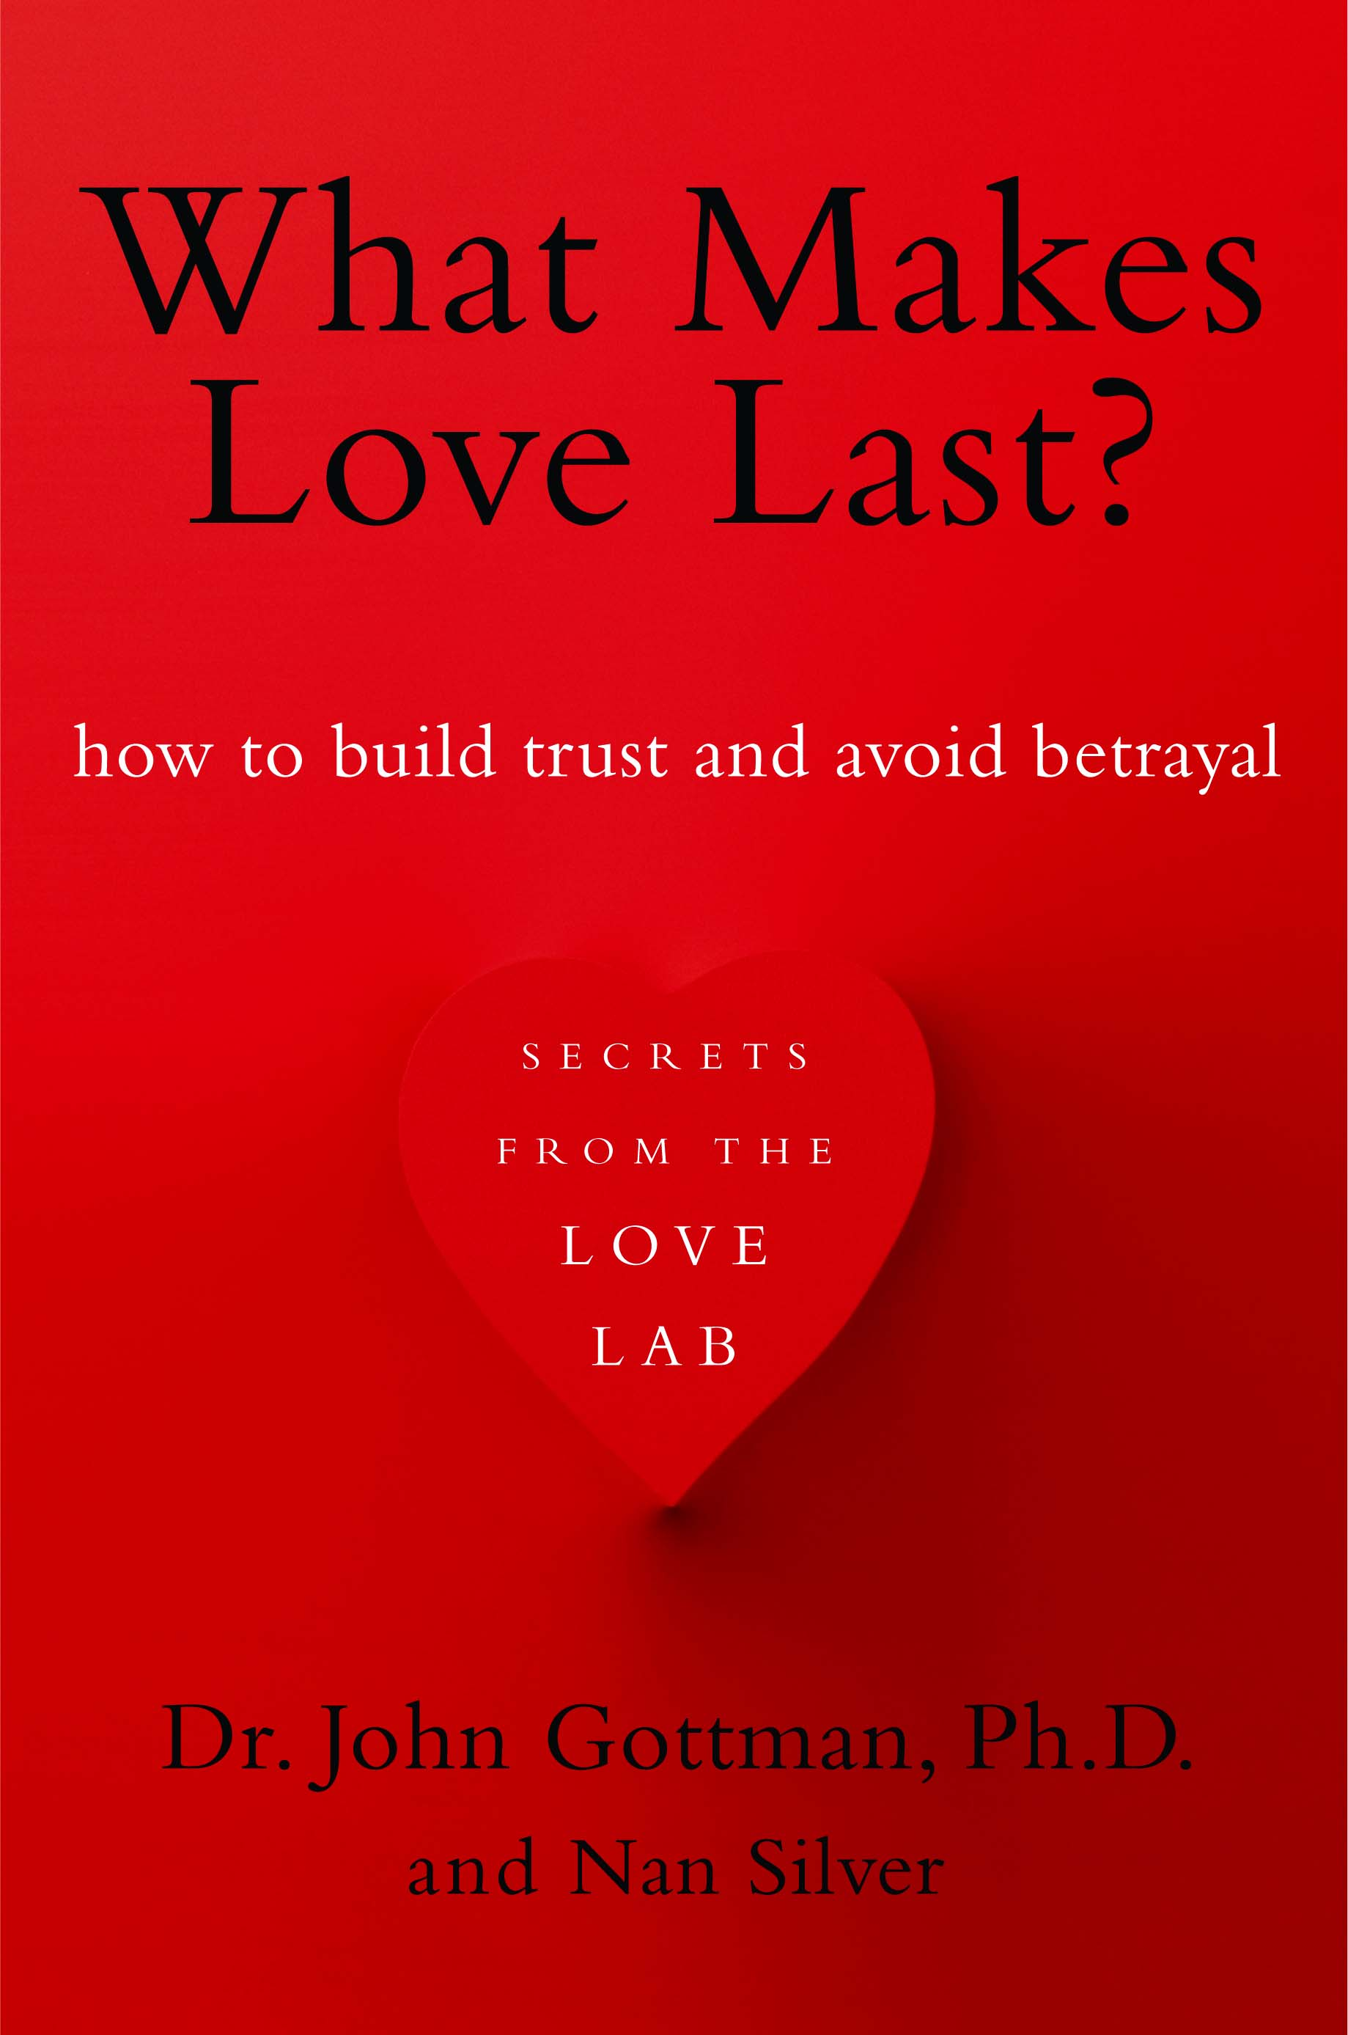

Slide 19
Let’s now talk about trust, loyalty, commitment, fairness, & betrayal

Slide 20
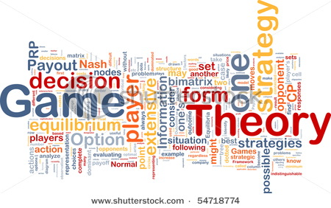

Slide 21
Game theory: A general theory of all social interactions
If I smile at my wife and she smiles back at me
I may highly value that return smile, and assign a high “payoff” to that return smile, thinking, “What a great smile! I am one lucky guy to have her as my wife.”
Or I may be disappointed by the return smile, assigning a low “payoff” to that smile, thinking, “I think I could do better elsewhere.”

Slide 22
Game theory can suggest:
How to create trust, betrayal, and fairness metrics,
These metrics can be computed in any interaction.
Not as traits, but at a micro level, using temporal dynamics
Define trust at a micro level
Something we BUILD as we interact

Slide 23
Game theory assumes partners are rational
Each partner seeks to maximize his or her payoffs in any transaction
Therefore RATIONAL = a self interest metric
Partners usually select the strategy that maximizes their own payoffs.
Harold Kelley’s did a simple experiment (1979): 100 couples rated how much they valued housework.
Let’s look at one couple, Al and Jenny

Slide 24
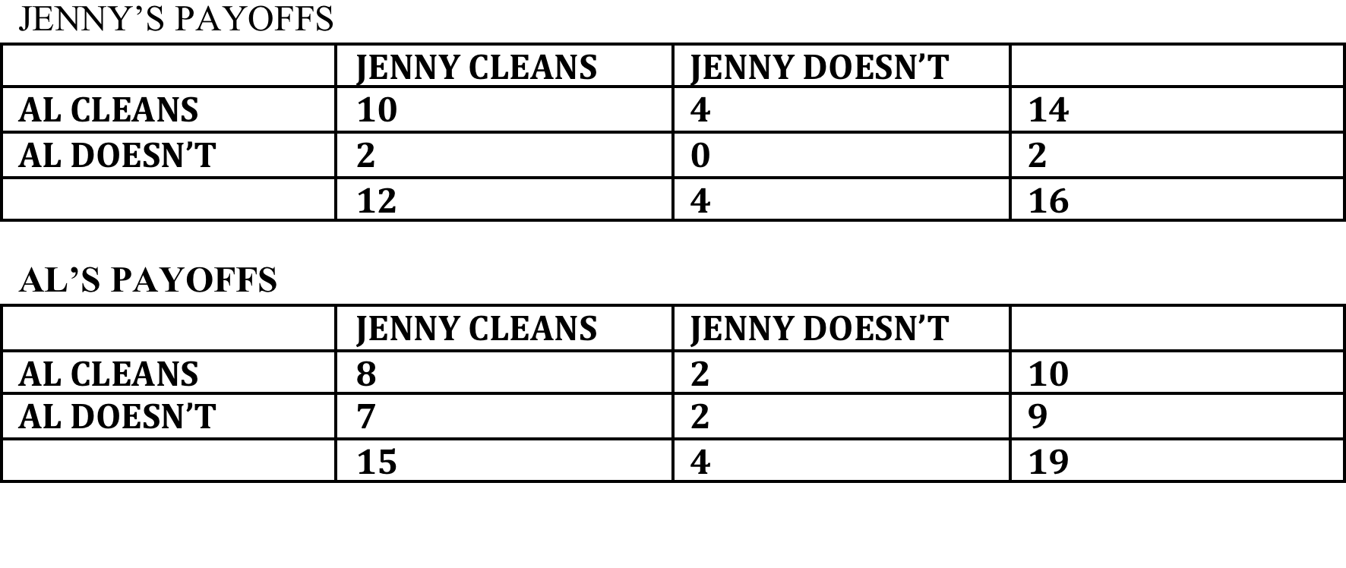
TABLE: A YOUNG COUPLE RATES HOUSEWORK
(0 = BAD TO 10 = GOOD)
Notes:
NOTE THAT JENNY’S PAYOFFS SHOW THAT REGARDLESS OF WHAT SHE DOES, GETTING AL TO CLEAN EARNS HER 12 POINTS. IF SHE CLEANS, REGARDLESS OF WHAT AL DOES, SHE ONLY EARNS 8 POINTS. AL EARNS 11 POINTS IF HE GETS JENNY TO CLEAN, BUT HIS CLEANING ONLY EARNS HIM ONE POINT. SO EACH WILL TRY TO GET THEIR PARTNER TO CLEAN.

Slide 25
With self-interest as the metric, Jenny will try to change Al and Al will try to change Jenny
Therefore, Jenny & Al will fight tooth and nail about housework. Typical of unhappily married couples.
BUT IF WE DEFINE TRUST AS THE METRIC IN WHICH:
Jenny is trying to maximize Al’s payoffs, and Al is also trying to maximize Jenny’s payoffs,
Then they will each decide to clean together, logically arriving at the maximum payoff for both. (THE “NASH EQUILIBRIUM”)
CONCLUSION IS:
TRUST = HAVING OUR PARTNER’S BACK, NOT JUST OUR OWN.
Can we generalize Kelly’s work as a game theory approach for all interactions? Answer is YES WE CAN! HERE’S HOW –GOTTMAN-LEVENSON PARADIGM:

Slide 26
How do couples build a high trust metric?
THE MAJOR QUESTION IS: “are you there for me?”
Trust is built in small moments via a social skill called, “attunement”
Which is fully “processing” a negative affect event
We first discovered this in research on Emotion coaching for kids,
Emotion Coaching tested in RCTs in Australia & Korea. Builds trust with kids, creates secure attachment.
Dan Yoshimoto’s attunement interview for couples – extended Emotion Coaching to couples via the “meta-emotion” interview.
Measures how much partners “there for one another,” particularly during moments of negative affect.

Slide 27
The biggest issue in all marital conflicts just a few months after the wedding

Slide 28

THE QUESTION OF TRUST OPENS UP LIKE A LARGE FAN
WILL YOU BE THERE FOR ME?

Slide 29
ARE YOU GOING TO BE THERE FOR ME?
CAN I TALK TO YOU? WILL YOU LISTEN AND EMPATHIZE? BE ON MY SIDE?
When I’m sad?
When you have hurt me?
When I’m angry with you?
When I’m hurt by your mother?
When I’m disappointed?
When I’m horny?
When I’m just upset?
When I’m lonely?
When I’m feeling trapped?
When I’m confused? DO I COME FIRST FOR YOU?

Slide 30
IF ANSWER IS “YES” THEN THEY BUILD TRUST - THEY “ATTUNE” = FULLY PROCESS A NEGATIVE EVENT
A = Awareness
T = Turning Toward
T = Tolerance
U = Understanding
N = Nondefensive Responding
E = Empathy

Slide 31
WHEN PARTNERS DON’T PROCESS A NEGATIVE EVENT BETWEEN THEM, THEN WE
GET THE ZEIGARNIK EFFECT
ZEIGARNIK EFFECT: WE RECALL UNFINISHED EVENTS BETTER THAN FINISHED EVENTS (RATIO = 1.9, MORTON DEUTCH).
  Reason for dreams? Process the unfinished.
  Basis of all neurosis? – Rumination on unprocessed, unfinished negative affect events.
“NOT FULLY PROCESSED” negative event = a “stone in one’s shoe.”
“FULLY PROCESSED” = Can talk about all negative affects without getting back into it -UNDERSTANDING

Slide 32
TRUST IS ALSO BUILT VIA ATTUNEMENT IN SIX “EMOTIONAL COMMAND” SYSTEMS we share with all mammals
Turning toward partner IN SIX EMOTIONAL COMMAND SYSTEMS
1. The Explorer (Seeking, anticipating, adventure, learning together) Dopamine. In humans a consequence of this system is The Philosopher and Storyteller (Building shared meaning)
2. The Sentry (Safety, reducing fear) Low Epinephrine
3. The Nest Builder (Emotional closeness – giving & receiving care) Oxytocin, Vasopressin, Cortisol; Panic and Grief are its opposites
4. The Jester (Humor, surprise, and play) Dopamine, Serotonin
5. The Commander-in-Chief (Power, dominance, anger, rage VS fairness, equality) Epinephrine, Norepinephrine, Cortisol, low Serotonin.
6. The Sensualist (Sensuality, orgasm) Testosterone.

Slide 33
ATTACHMENT THEORY
Is a very successful theory.
But, it only considers two of the six emotional command systems (The Sentry & The Nest Builder)
The theory assumes that if people feel safe and bonded, all the other systems will be fine (Broaden & Build the others)
Couple will be able to play, have adventures, have great sex and passion, and have no existential vacuum (Viktor Frankl)
We think this assumption is incorrect. INSTEAD WE THINK
The couples’ therapist needs to be a master of ALL six emotional command systems, including The Jester, the Explorer (and the Philosopher), The Commander-in-Chief, and the Sensualist.
So, our therapy has included TURNING TOWARD in all 6 emotional command systems.

Slide 34
TRUST IS BUILT BY: (1) BEING THERE FOR ONE ANOTHER AND (2) REPAIRING COMMUNICATION WHEN IT GETS MESSED UP
If we estimate the % time we are emotionally available, even generously, at 50%,
Probability both people will be emotionally available at the same time is 25% (assuming independence of these events)
So 75% is ripe ground for miscommunication, need for REPAIR
CONCLUSION: REGRETTABLE INCIDENTS ARE INEVITABLE, SINCE EMOTIONAL CONNECTION AND EMPATHY ARE RELATIVELY INFREQUENT
Negative affect just “happens.” So REPAIR IS ESSENTIAL for attachment security – Tronick & Gianino
More words for negativity than positivity in every human language. Negative affect stops you, positive affect accelerates you. We have to process negativity.

Slide 35
“BEING THERE” FOR PARTNER IN THE FACE OF NEGATIVE AFFECT.
Our hypothesis: Bonding is created by turning toward any NEGATIVE (or positive) AFFECT
Fully processing CONFLICT OR FAILURES TO CONNECT in any of the six emotional command systems has even MORE POWER TO CREATE TRUST than turning toward within any of the command systems.

Slide 36
BONDING IN THE CONTEXT OF NEGATIVE AFFECT IS POWERFUL. EXAMPLES ABOUND:
Yes, orgasms do build trust with Oxytocin, but not like:
Exploring in the face of fear (climbing mountains, space exploration)
Turning toward a neighbor in the face of natural disasters (Joplin, Missouri tornado)
Battle buddies in war. Which is why coming home after deployment conflict seems so trivial, and connection to family seems so bland.
Raising a child together;
Building shared meaning.
Orgasm pales in comparison to this kind of bonding.

Slide 37
MAJOR RESEARCH FINDING ON TRUST: ATTUNEMENT IS BUILT PRIMARILY BY PROCESSING EVERYDAY FAILURES TO COMMUNICATE
If it is fully processed, it is forgotten.
If it is not fully processed it becomes a stone in the shoe (Zeigarnik effect).
In our therapy, we use the Gottman Aftermath Kit (available on www.Gottman.com ) to fully process a regrettable incident that has happened in the past.
William Faulkner: “The past is never dead. In fact, it isn’t even past.”
.

Slide 38
CAN WE CHANGE DISTRUST TO TRUST? THE CAUSE-EFFECT EMPIRICAL QUESTION
YES WE CAN.
Randomized clinical trial with 80 couples. (Gottman & Ryan, 2012 – under review: J. of Family Therapy).
The Gottmans’ two-day “The Art & Science of Love” workshop significantly increases trust compared to a control group.
We get significant increases in the TRUST METRIC by increasing EMOTIONAL ATTUNEMENT in couples.
But it’s hard to get trust when relationships have a large power differential and they seem unfair. SO NEED TO BUILD A FAIRNESS METRIC.

Slide 39
The BETRAYAL METRIC

Slide 40
DEFINING THE BETRAYAL METRIC
There are many ways to betray. Deception, Lying, Affairs & Addictions are the major ways.
But betrayal begins in an ANY INTERACTION that becomes a non-cooperative power struggle:
A “ZERO SUM” GAME = BETRAYAL METRIC
  A Win-Lose conflict
  My gain is my partner’s loss
  Partner’s gain is my loss
BETRAYAL METRIC = EXTENT TO WHICH RATING DIALS NEGATIVELY CROSS - CORRELATED

Slide 42
THE BETRAYAL METRIC WORKS
IN OUR 20-YEAR LONGITUDINAL STUDY: Predicts early husband death. 58% versus 22% for cooperative metric, even controlling husband age and initial health
Our second study showed that this dynamic of earlier husband death is likely to be related to chronic elevations in baseline blood velocity of husband and wife due to chronic high myocardial contractility.
OPPOSITE OF BETRAYAL = LOYALTY

Slide 43
Using Betrayal Metric we get our FINAL SURPRISING RESEARCH FINDING:
THE GERM OF DISTRUST IS NOT THE SAME AS THE GERM OF BETRAYAL

Slide 44
WHAT BEGINS THE CASCADE TOWARDS BETRAYAL?
UNFAVORABLE NEGATIVE COMPARISONS
“I CAN DO BETTER THAN YOU”

Slide 45
BETRAYAL REQUIRES TURNING AWAY FROM PARTNER’S BID WITH A “NEGATIVE COMP”
Our theory: the germ of betrayal is turning away from a bid, Plus NEGATIVE COMP
What is a NEGATIVE COMP?
Judging a behavior exchange by comparing it UNFAVORABLY with real or imagined alternatives
So the “GERM of betrayal” - while turning away from a partner’s need,
  A NEGATIVE COMP is made: “I CAN DO BETTER”
Case of the man with a wife and mistress. Wife was “too needy” mistress was always so “positive”.

Slide 46
EXAMPLE OF COUPLE
JOHN SAW IN THERAPY
John was their 6th therapist.
They came into the 5th session and said this was their last session
Asked them, “Help me understand why the therapy had failed.”
We processed an argument they had.

Slide 47
THEIR REGRETTABLE INCIDENT
He met a woman at a party. His wife was tired & wanted to leave. He told his wife he was more attracted to that OTHER woman than to her.
They had a fight. She thought “I’d be happier with a more mature man.”
Both turned away from each other with a NEGATIVE COMP.
John understood why therapy didn’t work for them.
Alice in Wonderland & Commitment
2 months later, still together, working on “unconditional commitment”

Slide 48
FINDING: NEGATIVE COMPs BEGIN A CASCADE TOWARD BETRAYAL
NEGATIVE COMPs first measured successfully by the late & great Caryl Rusbult (first proposed by Thibaut & Kelley, 1959)
Rusbult’s 3 decades of research, the only work able to PREDICT sexual infidelity in dating couples.
All other studies start with infidelity and interview post hoc.
But people’s retrospective accounts are highly flawed.

Slide 49
FINDING: THERE ARE ORDERLY, DETERMINISTIC, GLACIAL CASCADES TOWARD EITHER BETRAYAL OR LOYALTY
The opposite of a NEGATIVE COMP is CHERISHING ONE’S PARTNER
Nurturing GRATEFULNESS for what one has
Instead of RESENTMENT for what one does not have
Maximizing partner’s positive traits, minimizing the negative as opposed to the opposite.
Next slides will describe the 24-step Cascade toward Betrayal

Slide 50
THE 24 STEP GOTTMAN- RUSBULT-GLASS (GRG) CASCADE TOWARD BETRAYAL
Turning away/dismissing, or turning against, few attunements
NEGATIVE COMPs accompany turning away/against.
3. Not “there for me” becomes the common event (turning toward 33% vs 86%)
4. Flooding/ physio arousal occurs whenever S#!T happens. Hypervigilance begins.
5. Conflict becomes a Markov absorbing state. Probability of entry to negativity is greater than probability of exit. Repair does not work.
6. Couple avoids conflict. Suppresses negative affect. Has Blowups (Unprocessed S#!T).

Slide 51
CASCADE TOWARDS BETRAYAL (CONT.)
7. Couple avoids Self-disclosure. Has secrets from partner. Deception begins.
8. Bidding for attunement declines.
9. Invests less in relationship.
10. Less dependency on relationship to get needs met. Confiding in others, not partner
11. Less sacrificing for relationship. SUBSTITUTING (find what’s not there elsewhere)

Slide 52
CASCADE TOWARD BETRAYAL (CONT.)
12. Maximizing partner’s negative traits in one’s mind. Defensiveness begins.
13. Minimizing partner’s positive traits. Criticism begins. Takes no responsibility for problems.
14. “Trashing” versus “cherishing”. Contempt begins. Shared Meaning erodes.
15. Trashing partner to others. Contempt builds. Deception builds. Story of Us gets neg.
16. Builds resentment vs. gratitude. Sees partner as SELFISH. Paradoxically, trusts PARTNER less. Stonewalling starts.
17. Loneliness in relationship builds. Vulnerability to other relationships starts.
18. Partner refusing sex becomes punishing. Little sex, romance, fun, play, adventure, courtship. No sexuality love maps, no dream love maps. Low sexual desire. Porn use may increase.

Slide 53
CASCADE TOWARDS BETRAYAL (CONT.)
19. Fewer pro-relationship cognitions. More anti-relationship cognitions.
20. No longer denigrating alternative relationships. Starts innocent new secret liasons.
21. Little fence between self & others. Reverses “walls & windows” (Shirley Glass)
22. Keeping more and more secrets from partner. Deception increases.
23. Actively turning toward others for needs. Seeking what’s not in relationship.
24. Crossing boundaries. Real betrayal unfolds. Deception becomes way of life. Risky.

Slide 54
Shirley Glass’s Huge Contribution
Took affairs out of the pulpit
Explained the natural social psychology of how most affairs happen
How people create secrets gradually by avoiding conflict and self disclosure of needs
And gradually give themselves permission to cross boundaries,
Reversing the “walls” and “windows” that loyal couples usually create.

Slide 55
Shirley Glass’s Not just friends
Four Principles from Glass’s pioneering work
1. Betrayed person has PTSD, including:
  Hypervigilance, emotional numbing alternating with explosions, unwanted intrusive thoughts and images with no control, flashbacks, depression, nightmares, excessive rumination.
2. 1st phase of therapy betrayed person needs to ask many questions to get answered without defensiveness (also Peggy Vaughan). Not questions about the sex between affair partners.
3. Must listen & empathize with feelings of betrayed partner and express remorse. This MUST precede examining dynamics of the relationship, or risk blaming the victim.
4. Betrayed partner can not use the Four Horsemen in expressing feelings.

Slide 56
ATONE-ATTUNE-ATTACH THERAPY:
HEALING FROM AN AFFAIR

Slide 57
PRELIMINARIES
ASSESSMENT: Gottman Questionnaire package, Conjoint interview with couple’s narrative, Oral History Interview, conflict discussion, plus individual interviews.
Make sure affair is really over, or don’t do therapy.
Set up rules for interaction at home about the affair
May need individual sessions with betrayer about grief in losing affair partner. Express empathy.
Using SRH diagram, outline the overall therapy to clients. Discuss building Marriage #2.

Slide 58
PHASE 1: ATONE
THE ATONEMENT DIALOGUE (Peggy Vaughan’s study; Shirley Glass’s work)
    Explain and explore the hurt partner’s PTSD.
    Hurt partner asks questions, betrayer practices transparent, non-defensive empathic listening.
    Betrayer needs to express deep remorse.
    Do not examine WHY the affair happened in this phase. It risks blaming the victim. Encourage betrayer to avoid sex related questions that create ruminations about sex details.

Slide 59
LISTENING TO HURT PARTNER’S EMOTIONS
    Expressions of negative emotions are okay, but not the Four Horsemen of the Apocalypse.
    Help hurt partner to only discuss affair in session at first. Otherwise, likely to escalate.
    In between sessions, hurt partner can do “feeling downloads” on therapist’s voicemail or in journal.

Slide 60
EXPLORE ATONEMENT NEEDS
What kind of atonement does hurt partner need from betrayer partner?
Going forward, what kind of transparency does hurt partner need from betrayer partner? (Maybe checking cell phone, VM, and texting messages, e-mails, phone calls 24/7 if one partner is traveling, receipts, etc.)

Slide 61
PHASE 2: ATTUNE
End Conflict Avoidance. Use GOTTMAN-RAPOPORT BLUEPRINT AND DREAMS-WITHIN-CONFLICT to create new conflict management system.
When partners locked into attack-defend, use the DAN WILE INTERVENTION, plus partner using his or her own words during re-statement.
Learn individual signs of getting flooded, and create ritual for taking breaks.

Slide 62
Gottman-Rapoport Blueprint – replaces active listening. Use Pulse Oximeters.
SPEAKER bullet points:
1. No blaming, no YOU statements
2. I-STATEMENTS How you feel about a specific incident
3. POSITIVE NEED: What you want and need. Behind every negative affect there is a longing, a wish
Avoid physiologically FLOODING the Listener
LISTENER bullet points:
1. Take notes
2. Summarize partner’s position and affect
3. Validate with empathy
Principles
1. Postpone persuasion until each partner can summarize other to his or her satisfaction.
2. Stay in WHAT’S THIS? Mode instead of WHAT THE HELL IS THIS? Mode.

Slide 63
DREAMS WITHIN CONFLICT INTERVENTION
When Conflict is Gridlocked (Compromise seems unthinkable, like selling one’s self out for sake of peace).
Postpone problem solving. Goal is understanding.
Listener asks:
Do you have any core beliefs, ethics or values that are part of your position on this issue?
Is there a story behind this for you, or does this relate to your background or childhood
history in some way?
Tell me why this is so important to you.
What feelings do you have about this issue?
What would be your ideal dream here?
Is there a deeper purpose or goal in this for you?
What do you wish for?
What do you need?
Is there a fear or disaster scenario in not having this dream honored?

Slide 64
ATTUNE (CONT.)
Use AFTERMATH OF A REGRETTABLE INCIDENT intervention to process regrettable incidents or fights.
Goal: Healing from past emotional wounds
How we use the Dan Wile intervention.

Slide 65
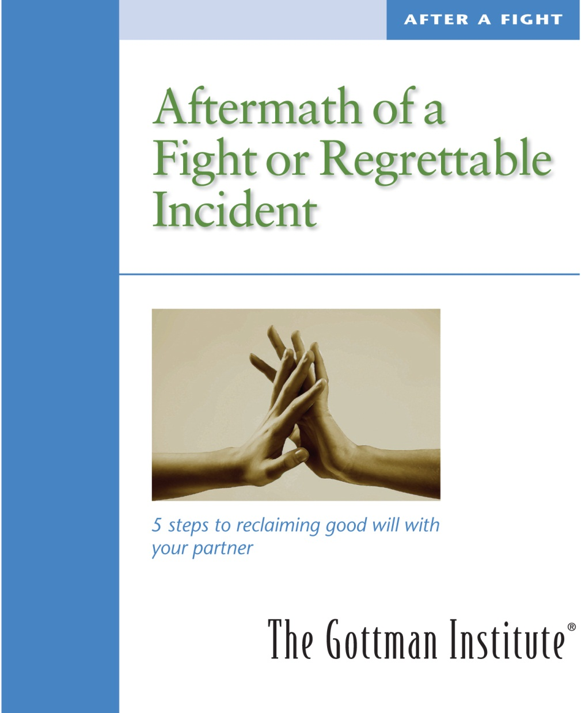

Slide 66
Aftermath of a Fight or Regrettable Incident
This exercise is for “processing” past fights, regrettable incidents or past emotional injuries. “Processing” means that you can talk about the incident without getting back into it again. It needs to be a conversation – as if you were both sitting in the balcony of a theater looking down on the stage where the action had occurred. This requires calm and some emotional distance from the incident.
Before you begin
Keep in mind the GOAL is greater understanding – addressing the process and how the issue was talked about, without getting back into the fight. So, wait until you’re both calm. We assume that each of your realities has validity. Perception is everything. Don’t focus on “the facts.” Pay attention to the common barriers to communication and their antidotes as you move through the process. Keeping the “Four Horsemen” diagram handy can help.

Slide 67
Work through the following five steps together.
The Five Steps
Feelings: Share how you felt. Do not say why you felt that way. Avoid commenting on your partner’s feelings.
Realities: Describe your “reality.” Take turns. Summarize and validate at least a part of your partner’s reality.
Triggers: Share what experiences or memories you’ve had that might have escalated the inter-action, and the stories of why these are triggers for each of you.
Responsibility: Acknowledge your own role in contributing to the fight or regrettable incident.
Constructive Plans: Plan together one way that each of you can make it better next time.

Slide 68
Step One: Feelings
Share how you felt. Do not say why you felt that way. Avoid commenting on your partner’s feelings.
I felt...
defensive
not listened to
feelings got hurt
totally flooded
angry
sad
unloved
misunderstood
criticized
took a complaint
personally
like you didn’t even like me
not cared about
worried
afraid
unsafe
tense
I was right and you were wrong
both of us were partly right
out of control
frustrated
righteously indignant
morally justified
unfairly picked on
unappreciated
disliked
unattractive
stupid

Slide 69
I felt... (continued)
morally outraged
taken for granted
like leaving
like staying and talking this through
I was overwhelmed
with emotion
not calm
stubborn
powerless
I had no influence
I wanted to win this one
my opinions didn’t even matter
there was a lot of give and take
I had no feelings at all
I had no idea what I was feeling
lonely
alienated
ashamed
guilty
culpable
abandoned
disloyal
exhausted
foolish
overwhelmed
remorseful
shocked
tired

Slide 70
Step Two: Realities
Describe your “reality.” Take turns. Summarize and validate at least a part of your partner’s reality.
Subjective Reality and Validation
Take turns describing your perceptions, your own reality of what happened during the regrettable incident. Describe yourself and your perception. Don’t describe your partner. Avoid attack and blame. Talk about what you might have needed from your partner. Describe your perceptions like a reporter, giving an objective blow-by-blow description. Say “I heard you saying,” rather than “You said.”
Summarize and then validate your partner’s reality by saying something like, “It makes sense to me how you saw this and what your perceptions and needs were. I get it.” Use empathy by saying something like, “I can see why this upset you.” Validation doesn’t mean you agree, but that you can understand even a part of your partner’s experience of the incident.
Do both partners feel understood? If yes, move on. If no, ask, “What do I need to know to understand your perspective better?” After summarizing and validating, ask your partner, “Did I get it?” and “Is there anything else?”

Slide 71
Step Three: Triggers
Share what experiences or memories you’ve had that might have escalated the inter-action, and the stories of why these are triggers for each of you.
As you rewind the video tape of your memory, stop at a point where you had a similar set of feelings triggered in the past. Now tell the story of that past moment to your partner, so your partner can understand why that is a trigger for you.
Share your stories – it will help your partner to understand you. As you think about your early history or childhood, is there a story you remember that relates to what got triggered in you, your “enduring vulnerabilities”? Your partner needs to know you, so that your partner can be more sensitive to you.

Slide 72
Examples of triggers
I felt judged. I’m very sensitive to that.
I felt excluded. I’m very sensitive to that.
I felt criticized. I’m very sensitive to that.
I felt flooded.
I felt ashamed.
I felt lonely.
I felt belittled
I felt disrespected.
I felt powerless.
I felt out of control.
Other:
Validation
Does any part of your partner’s triggers and story make sense to you?

Slide 73
Step Four: Responsibility
Acknowledge your own role in contributing to the fight or regrettable incident.
Under ideal conditions, you might have done better at talking about this issue.
1. What set me up for the miscommunication
  Share how you set yourself up to get into this conflict.
Read aloud the items that were true for you on the following list:
What set me up:
I’ve been very stressed and irritable lately.
I’ve not expressed much appreciation toward you lately.
I’ve taken you for granted.
I’ve been overly sensitive lately.
I’ve been overly critical lately.
I’ve not shared very much of my inner world.

Slide 74
What set me up: (continued)
I’ve not been emotionally available.
I’ve been turning away more.
I’ve been getting easily upset.
I’ve been depressed lately.
I’ve had a chip on my shoulder lately.
I’ve not been very affectionate.
I’ve not made time for good things between us.
I’ve not been a very good listener lately.
I’ve not asked for what I needed.
I’ve been feeling a bit like a martyr.
I’ve needed to be alone.
I’ve not wanted to take care of anybody.
I have been very preoccupied.
I haven’t felt very much confidence in myself.
I’ve been running on empty.

Slide 75
2. Specifically what do you regret, and specifically, what was your contribution to this regrettable incident or fight?
3. What do you wish to apologize for?
(Read aloud) I’m sorry that:
  1. I over-reacted.
  2. I was really grumpy.
  3. I was defensive.
  4. I was so negative.
4. If you accept your partner’s apology, say so.
If not, say what you still need.

Slide 76
Step Five: Constructive Plans
Plan together one way that each of you can make it better next time.
Share one thing your partner can do to make a discussion of this issue better next time.
(It’s important to remain calm as you do this.)
Then, while it’s still your turn, share one thing you can do to make it better next time.
What do you need to be able to put this behind you and move on? Be as agreeable as possible to the plans suggested by your partner.
Write your plan to make it better:

Slide 77
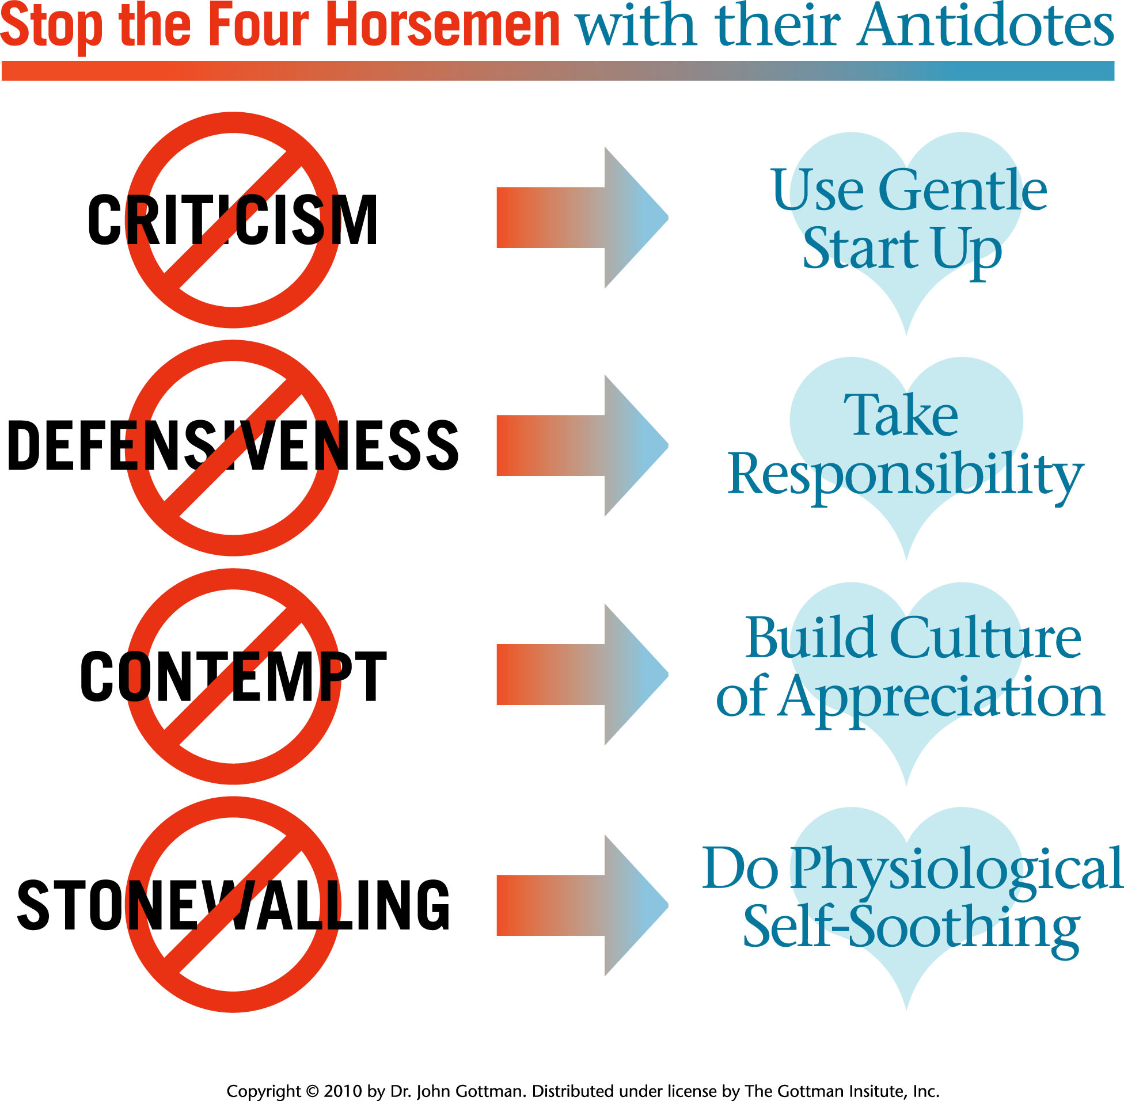

Slide 78
ATTUNE: (CONT.)
Explore why the affair happened by personalizing the Gottman-Rusbult-Glass Cascade model.
Use Love Maps and Open-Ended Question Card Decks to rebuild knowledge of one another.

Slide 79
ATTUNE (CONT.)
Encourage expression of fondness, admiration, and appreciation. May be one-sided at first due to betrayed partner’s fear of getting close again.
Learn how to recognize and turn towards bids during “sliding door” moments. May also be more one-sided, as betrayed partner needs time to rebuild trust.
Process failed bids using AFTERMATH OF REGRETTABLE INCIDENTS.

Slide 80
ATTUNE: (CONT.)
Set up weekly 1-hour State of the Union meetings
Ritualize cherishing and gratitude, rather than trashing and resentment
Practice the STRESS-REDUCING CONVERSATION,
Bring up problems by saying, “Here’s what I do need,” rather than, “Here’s what I don’t need.”
Use DREAMS WITHIN CONFLICT intervention if necessary (gridlocked existential issue)

Slide 81
FILM OF PAUL AND SHANTEL
Paul had dad who was physically abusive with many affairs. Paul started dealing drugs at 12 – by 22 making $20,000/week as dealer.
Met Shantel when he was 18, she was 16, had first child at 20 .
Shantel had mom who was heroin addicted and dad in jail. Raised by grandma (physically abusive) and uncle and aunt (sexually abusive). Severe neglect.

Slide 82
PAUL AND SHANTEL
Paul had many affairs for first 8 years. “Counting notches on his belt.”
At 25, his truck hijacked, he was shot 5 times, 12 hrs. of surgery, nearly died twice.
“Conversion experience”
He and Shantel left drug world, became lay ministers and organized center for teens on streets.

Slide 83
FILM
Dream within conflict intervention to deal with perpetual conflict over whether or not to give gifts more than once or twice a year.

Slide 84
PHASE 3: ATTACH
Use RITUALS OF CONNECTION INTERVENTION to create ways of connecting that both partners can count on.
Build pro-relationship language and thoughts and build towards renewed commitment.
Turn towards by sacrifice, mutual investment, and effective interdependence.

Slide 85
ATTACH (CONT.)
Learn the skills of intimate conversation using GottSex Kit.
Create personal sex and intimate trust using GottSex Kit, with betrayed partner in charge of timing.
Re-build new shared meaning system (may use the DREAMS-WITHIN-CONFLICT intervention)

Slide 86
DEBBIE AND JAKE: Preliminaries
D’s Locke-Wallace, 11; Jake’s 87.
D’s Weiss Cerretto, 14; Jake’s 6
Narrative:
D confronted J many times; J denied affairs
D hired private detective.
Detective discovered J had prostitutes in 6 cities plus one serious affair in Hong Kong.
D had moved out day after detective’s report.

Slide 87
PRELIMINARIES (CONT.)
D confronted J with photos and e-mails. Furious.
D and J owned jewelry business together.
D’s lawyer advised continued co-ownership of business.
J had begged for one last try.
D contacted me.

Slide 88
PRELIMINARIES (CONT.)
All of D’s SRH questionnaires extremely negative, with friendship, romance and passion, and shared meaning at 0, and conflict scores all extremely high.
J’s scores more moderate with average scores on friendship, but also high conflict scores, especially in Four Horsemen.

Slide 89
TREATMENT PLAN
Explained PTSD to D and J
Asked for commitment from J to hang in there with D’s questions, and to only tell the truth.
Asked D for commitment to keep discussions of affair in sessions and not between them, with alternatives offered if necessary (VM download).
Discussed SRH needs in building Marriage #2.

Slide 90
ATONE
For 20 sessions over 6 months, Debbie asked questions and voiced feelings.
Reviewed hundreds of e-mails, including those between Jake and his friends prior to their reunions in Las Vegas.
D expressed much pain and anger.
J at times got defensive, was gently supported by therapist to not do so.

Slide 91
ATONE (CONT.)
Deb’s PTSD was severe at first with nightmares, insomnia, persistent unwanted thoughts and images, numbness altering with explosive feelings, depression, and weight loss.
Gradually it lessened. Taught her progressive relaxation and some visual imagery methods to help with insomnia and anxiety.

Slide 92
ATONE (CONT.)
Deb’s attorney coached her to demand more financially and materially.
Deb decided to fire the attorney, but not drop the divorce filed paperwork as yet.
Turning Point: J had visual image of himself hanging from street lamp – he interpreted its meaning as his own self-destructiveness via affairs and destroying his marriage.

Slide 93
ATONE (CONT.)
J begs D’s forgiveness. Asks for D’s needs to take him back.
D states needs regarding time home after dinner, date nights, vacation time.
D also asks for new ring and new commitment.
J agrees – they pick out ring together.

Slide 94
ATTUNE
D and J work hard on conflict blueprint.
D presents gridlocked problem of J spending 3 hrs. at gym nightly after work.
D states no point in moving home if J still gone every evening.
They do Dream-Within Conflict Intervention.

Slide 95
ATTUNE (CONT.)
J explains need to body-build, being 5’4” tall.
J describes bullying he endured.
J also describes physical abuse by his father.
No tears from J, but D cries in hearing details.
D describes loneliness of dinners alone at night, evenings alone, and emotional distance that results.
D details earlier loneliness in childhood with isolated abusive parents and being only child, leaving her vulnerable to rejection.

Slide 96
ATTUNE (CONT.)
D and J compromise – J will go to gym 3 eves/week and once on weekend.
D and J will go out to dinner twice week to again connect with one another.
J needs D to be less critical of him when she’s unhappy – Criticism shuts him down.
Taught softened start-up.

Slide 97
ATTUNE (CONT.)
J needs to do buying trip.
Since on these trips, J saw affair partners, D panics.
J agrees to D’s right to call him 24/7.
J agrees to nightly stress-reducing conversations with D.
For end of his trip, they agree to meet in Mexico for week-long vacation.

Slide 98
ATTUNE (CONT.)
Day before J leaves, D slips into escalated 4-Horsemen.
Emergency session using Aftermath of a Regrettable Incident kit.
D’s escalation explored vis-à-vis PTSD triggers.
D agrees to weekly individual sessions until joins J in Mexico.

Slide 99
ATTACH
D moves back in with J post-Mexico.
D and J work on Rituals of Connection, including dinners, end-of-day reunions, date nights, and strengthening sex life.
D and J work on Shared Meaning system, regarding helping out D’s adult-aged daughter (from former marriage)

Slide 100
ATTACH (CONT.)
D and J continue to work on Open-Ended Questions and Shared Meaning system regarding work, future retirement dreams, and daughter and son-in-law’s imminent return to Seattle.
J and D strategize regarding repair of J’s ruptured relationship with daughter due to affairs.

Slide 101
ATTACH (CONT.)
Daughter and son-in-law successfully transition back to Seattle.
Family session held where daughter airs anger and hurt at J’s past behavior.
J does good job at acknowledging responsibility, apologizing, and not getting defensive.

Slide 102
ATTACH (CONT.)
D and J begin phase-out of treatment, cutting back to once month for 3 months, then termination
Three years post-treatment. So far, so good.

Slide 103
THANK YOU FOR LISTENING

